Slide 1
Random Forest Methodology
Dataset
Select the best training data and function
1. To balance class
2. Select Function
3. Select features
Raw data
Down sampled data
Repeat balanced data
Smote balanced data
RandomForest( )
Ranger( )
ordinalForest( )
All features
Lasso selected features
5-fold Cross validation for hyperparameter tuning
Number of trees: 1000, 2000, 4000, 6000, 8000, 10000
Number of variables: 2, 3, 4, 5, 6
Fit model and results interpretation
Notes:
For random forest algorithm, we first tried different dataset to balance the class, and 3 different functions, and also the feature selection.
We found, using down sampled data, ranger, and all features, generate the best sensitivity with test data.
We then performed hyperparameter tuning, the best number of trees is 8000, and the number of variables in each tree is 2.

Slide 2
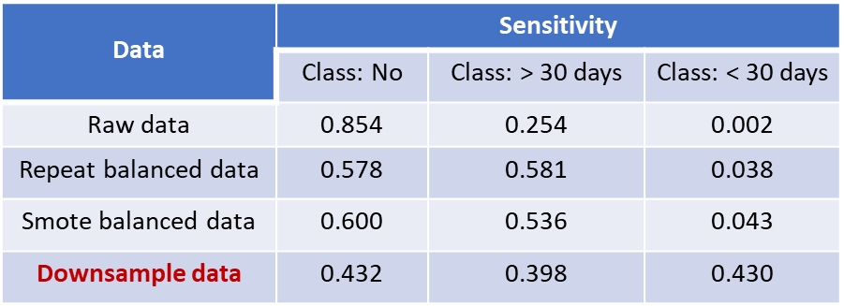
Dataset
Select the best training data and function
1. To balance class
2. Select Function
3. Select features
RandomForest( )
Ranger( )
ordinalForest( )
All features
Lasso selected features
Cross validation for hyper-parameter tuning
Number of trees: 1000, 2000, 4000, 6000, 8000, 10000
Number of variables: 2, 3, 4, 5, 6
* Red highlights indicate best performance
Fit model and results interpretation
Notes:
For random forest algorithm, we firstly tried different dataset to balance the class, and found only down sample data is able to pick up the (“patients that readmitted within 30 days” or “minority class group”).
Also ranger, and all features, generate the best sensitivity with test data.
We then performed hyperparameter tuning, the best number of trees is 8000, and the number of variables in each tree is 2.

Slide 3
Data | Sensitivity
 | Class: No | Class: > 30 days | Class: < 30 days
Raw data | 0.854 | 0.254 | 0.002
Repeat balanced data | 0.578 | 0.581 | 0.038
Smote balanced data | 0.600 | 0.536 | 0.043
Downsample data | 0.432 | 0.398 | 0.430

Slide 4
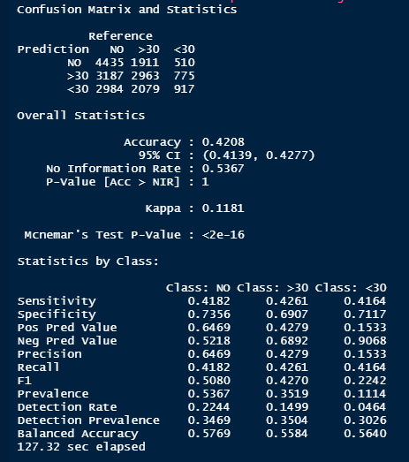
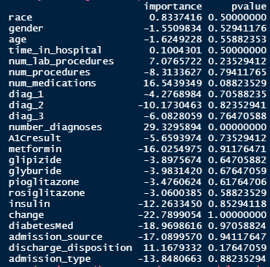
Random Forest Result
Notes:
We fit the model with best hyperparameters, and made prediction using test data, and found the sensitivity to identify each class is around 41%.
In all the variables, only the number of diagnoses has p value less than 0.05, suggesting number of diagnosis is the key factor affecting the readmission of patients.

Slide 5
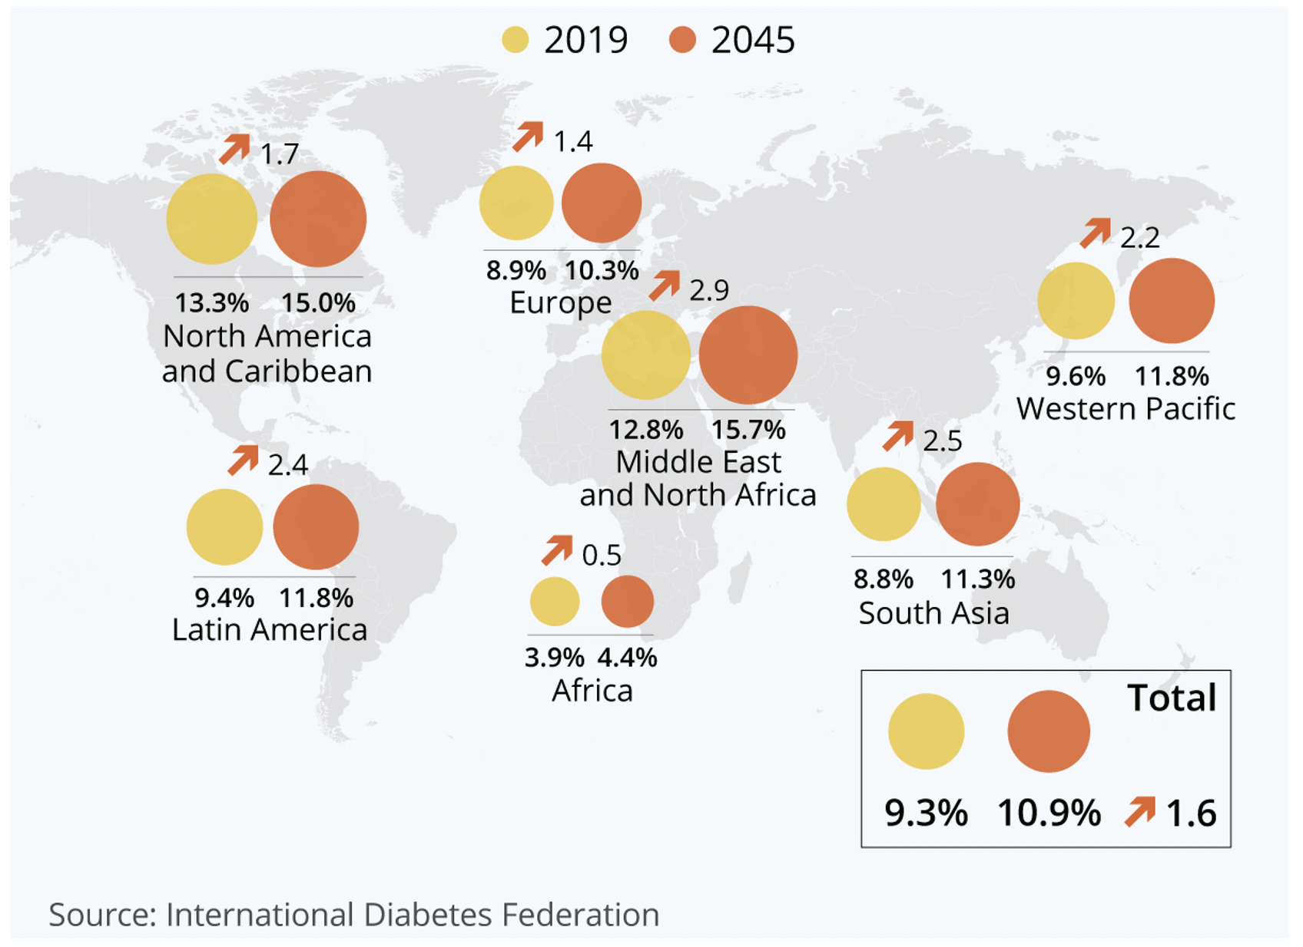
Prevalence of diabetes
Hospitalized diabetes patients have a higher risk of hospital readmission.
This generates significant burden to the patients and the health care system.
Identifying this group of patients will improve the management of the high readmission rate.
Notes:
Diabetes is a common disease with prevalence rising rapidly all over the world.
Hospitalized diabetes patients have a higher risk of hospital readmission after discharge from hospital

Slide 6
Problem
Hospitalized diabetes patients have a higher risk of hospital readmission.
This generates significant burden to the patients and the health care system.
In this study, we will use classification algorithms to:
predict whether the diabetes patients will be readmitted to hospital within 30 days or after 30 days, or will not be readmitted.
identify the potential factors affecting the readmission of diabetes patients.
The results will reduce the readmission of diabetes patients and health burden.

Slide 7
Combine classes: class “<30 days” and class “>30 days”
Increase observation numbers
Reduce categorical variable levels
Adjust threshold to improve sensitivity of existing models
Try other classification algorithms, including:
Linear Discriminant Analysis
Adaboosting
Classification Neural Network
Notes:
There are several ways we can improve the performance of the model. First, combine the two classes, patients readmitted within 30 days and after 30 days, which have similar clinical meanings.
Increase observation number, reduce categorical variable levels, adjust threshold for existing models, and try other classification algorithms.

Slide 8
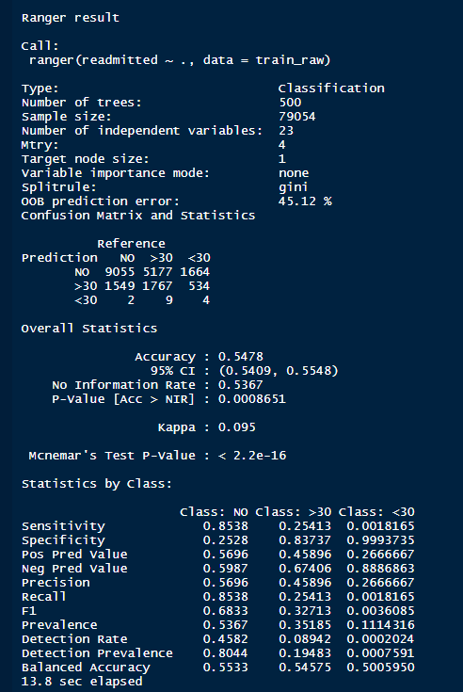
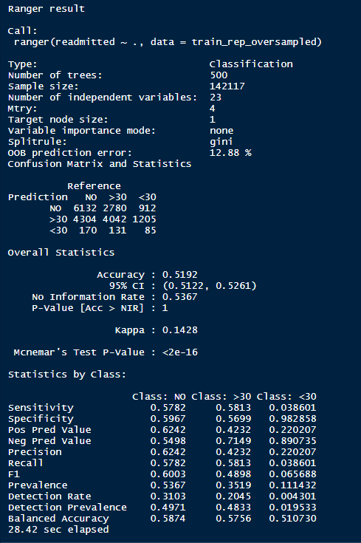
Balance class
Raw data
Repeated data

Slide 9
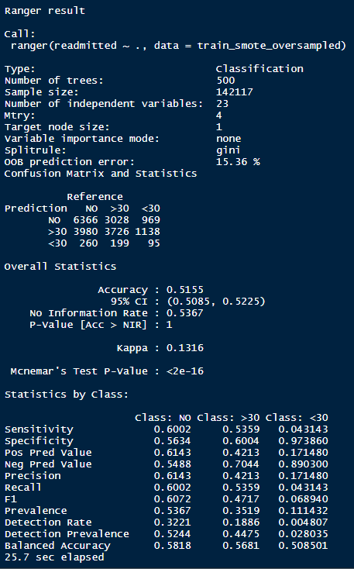
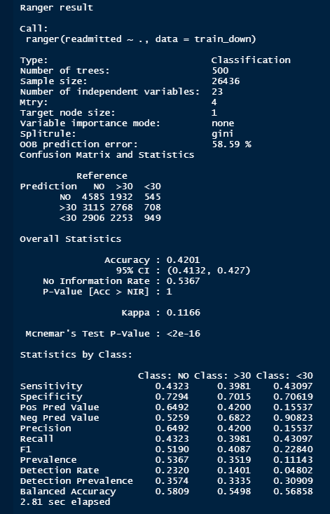
Balance class
Smote data
down data

Slide 10
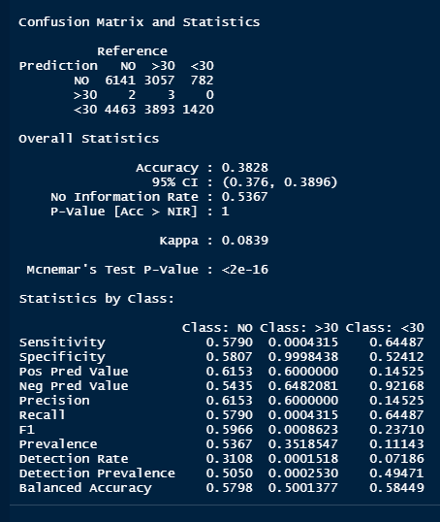
Choose function
ranger
Ordinal forest

Slide 11
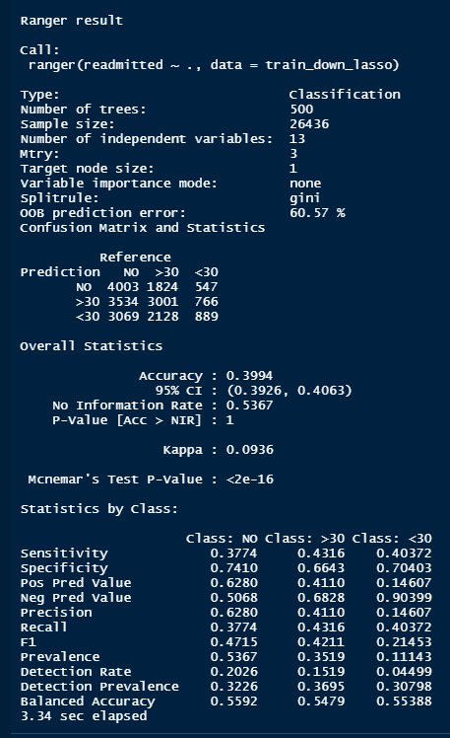
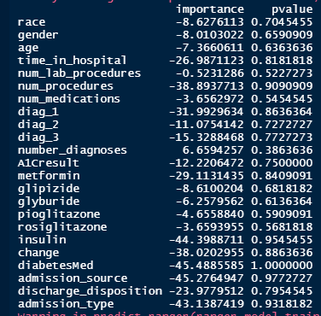
Feature selection
All features
Lasso features

Slide 12
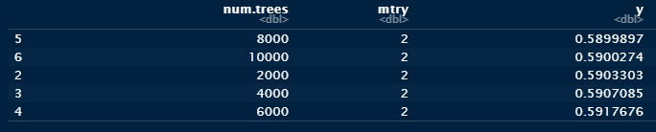
Hyper-parameter tuning

Slide 13
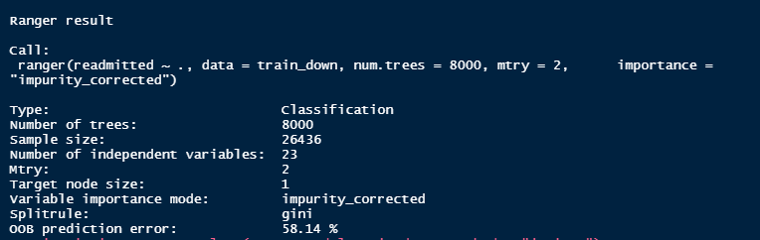
Fitting and evaluation

